Slide 1
Weekly Meeting (# 3)
TEA; PME; NTHU;
Good Afternoon Everyone
Microphone far-field array signal processing - Source amplitude estimation using Particle Filters.
Proof Reading of the Estimation theory section in Prof. Bai’s book.
Pseudo Code for the particle filters (SIR Algorithm).
Simulation in MATLAB;
With linear array of microphones.
With 2-dimensional array of microphones.
Results; Plots;

Slide 2
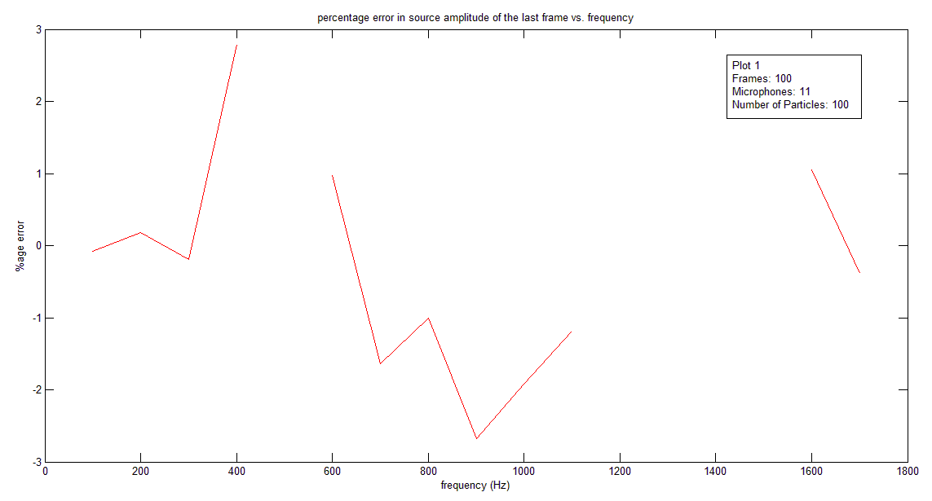
Simulation Results: Linear array of 11 microphones

Slide 3
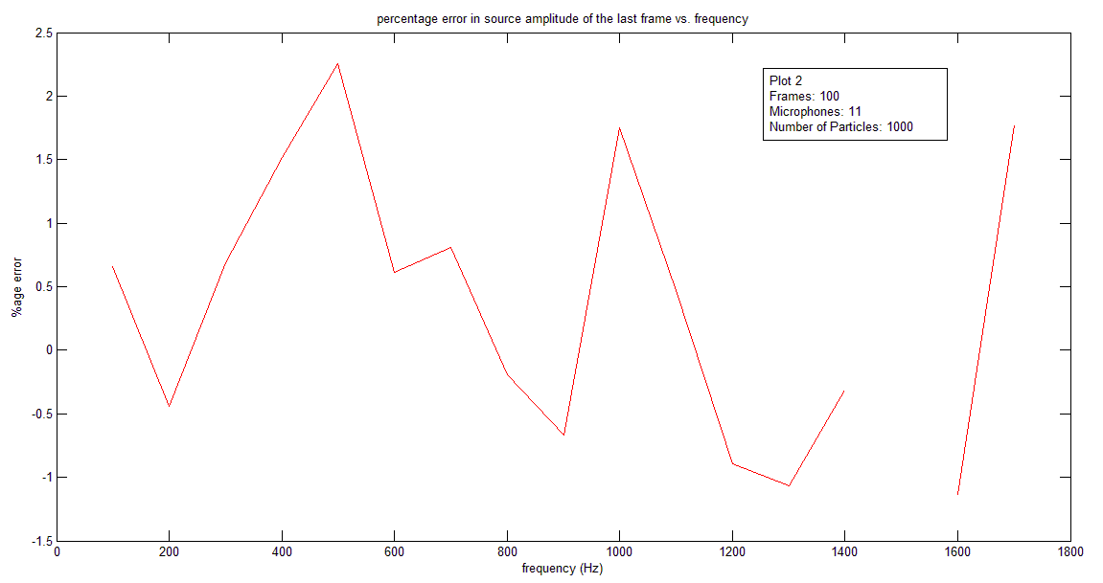

Slide 4
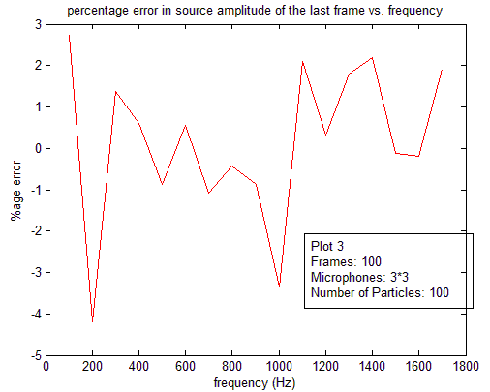
2 Dimensional array (3✗3 grid of 9 microphones)

Slide 5
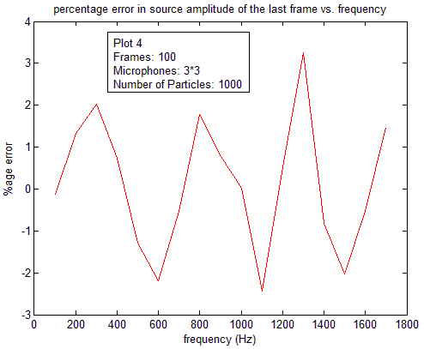

Slide 6
Comments and Conclusions
The error bandwidth decreases for 2 dimensional arrays as compared to linear arrays which shows greater accuracy in estimation.
For linear arrays, the graphs are discontinuous i.e. the error points are not plotted for certain frequencies. This may be the result of error going very large (and therefore NaN) when source amplitude tends to zero. This is not the case with 2 dimensional arrays which shows the true states also never deviate much from the initial amplitude.

Slide 7
Things to do next…
Search the reason for missing error points at particular frequencies in case of linear array.
Literature Study: “A Bayesian approach to sound source reconstruction: Optimal basis, regularization, and focusing”
Try the same problem with multiple sources (code written, debugging left).
Calculate the normal velocity and compare the results with C. C. Chen’s Paper.
Match the results obtained with MVU and Kalman Filter techniques.
Use MLE for the same problem and compare the results with particle filter results.
Apply EM Expectation maximization algorithm to the same problem.
Make JASA paper outline under following section headings:
Introduction
Theoretical background
How this problem can be fitted into particle filter framework
Simulation and Results
Conclusions

Slide 8
Thank you for listening

